Slide 1
Fundamentals of Electric Transmission System Planning
Talk 5: Power Flow for Large-Scale Systems, Part 2
Prof. Tom Overbye
Dept. of Electrical and Computer Engineering
Texas A&M University
overbye@tamu.edu

Slide 2
37-Bus System Generator Voltage Control and Generator Reactive Power Limits
Generator’s are often used to regulate a voltage magnitude by varying their reactive power output
Physically this is done by the generator’s exciter
Usually generators are modeled with reactive power limits (which may be dependent on the MW output)
The simplest type of control is a single generator regulating its terminal voltage magnitude
Sometimes multiple generators, perhaps at different buses, are regulating a single bus voltage magnitude

Slide 3
Generator Reactive Power Limits
The reactive power output of generators varies to maintain the terminal voltage; on a real generator this is done by the exciter
To maintain higher voltages requires more reactive power
Generators have reactive power limits, which are dependent upon the generator's MW output
These limits must be considered during the power flow solution
During power flow, once a solution is obtained, check to make generator reactive power output is within its limits
If the reactive power is outside of the limits, fix Q at the max or min value, and resolve treating the generator as a PQ bus
this is know as "type-switching"
also need to check if a PQ generator can again regulate
Rule of thumb: to raise system voltage we need to supply more vars

Slide 4
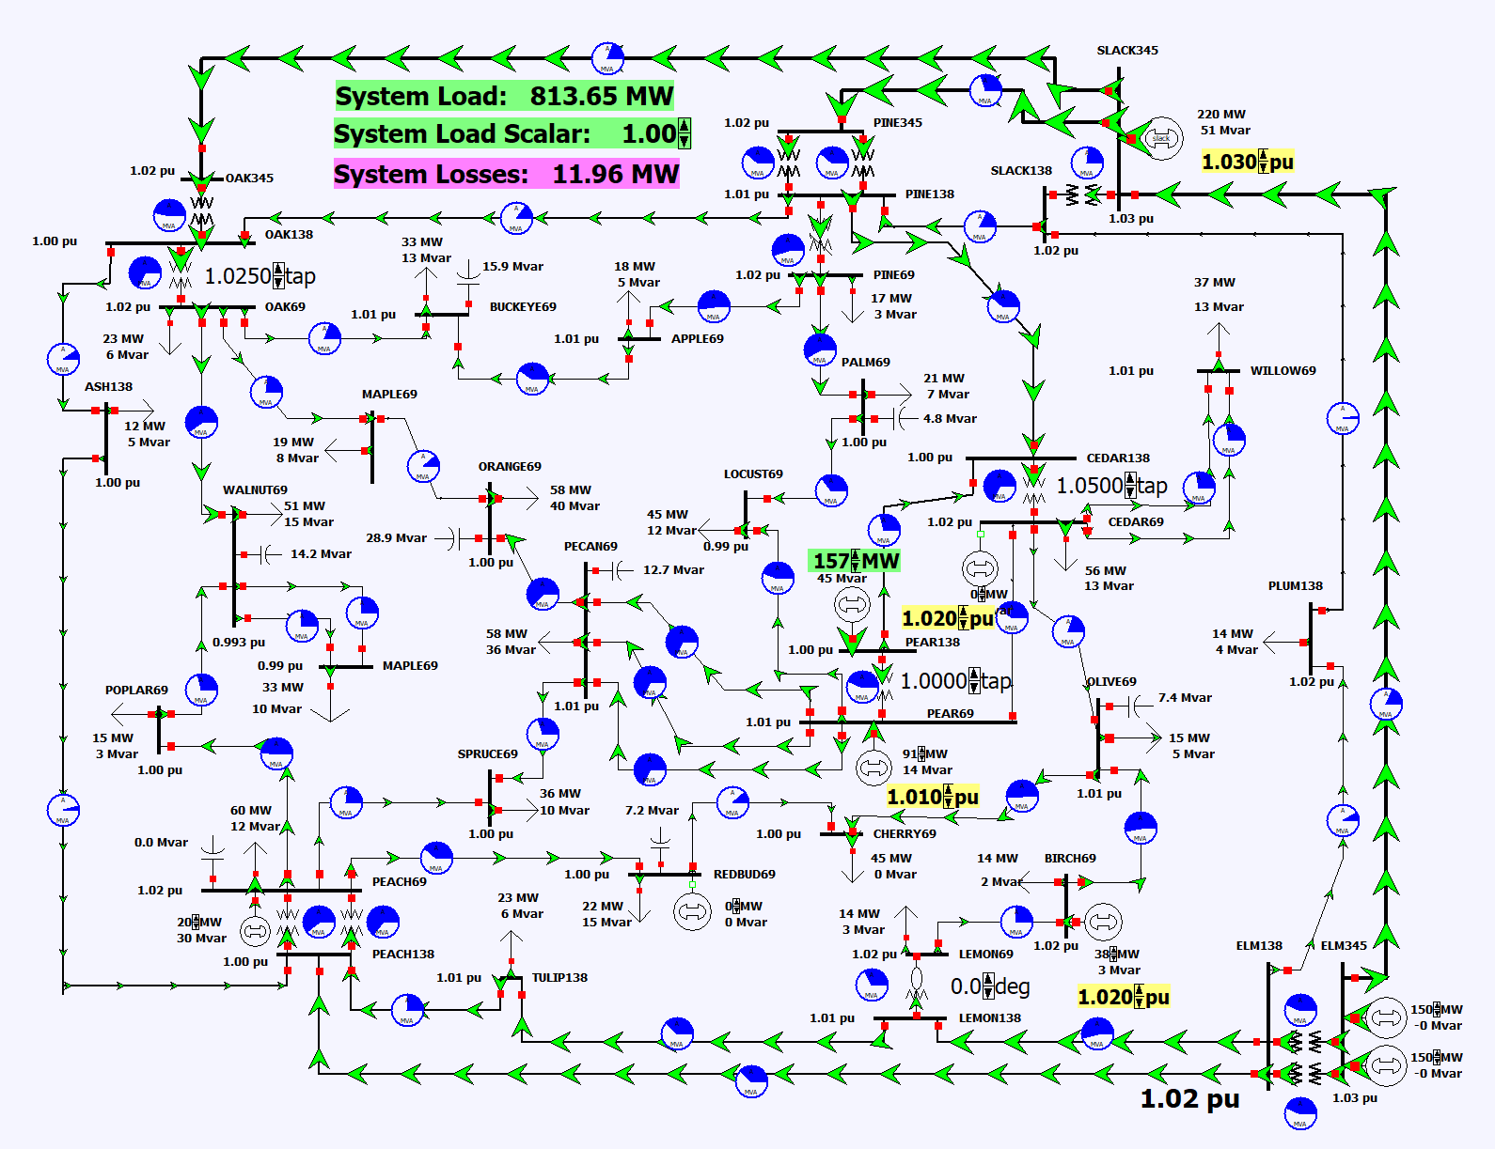
Generator Voltage Control Example
In the Talk 5 directory, open the case PSC_37Bus_VoltageContour and start the simulation.
Use the yellow fields at adjust the voltage setpoints at several of the generators
Notice how the changes affect the generator reactive power outputs and the system-wide voltages

Slide 5
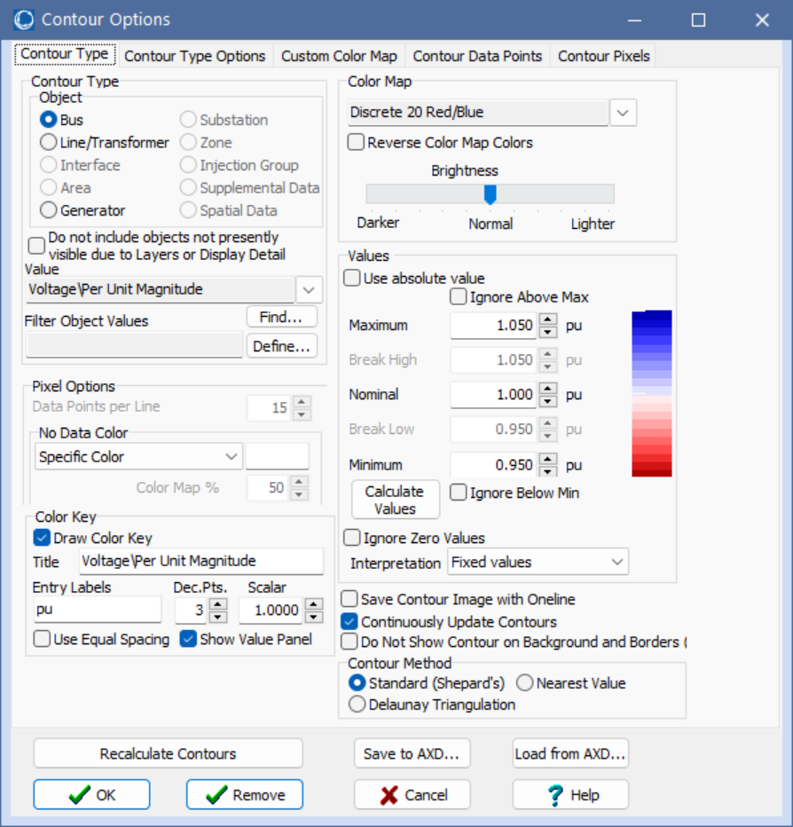
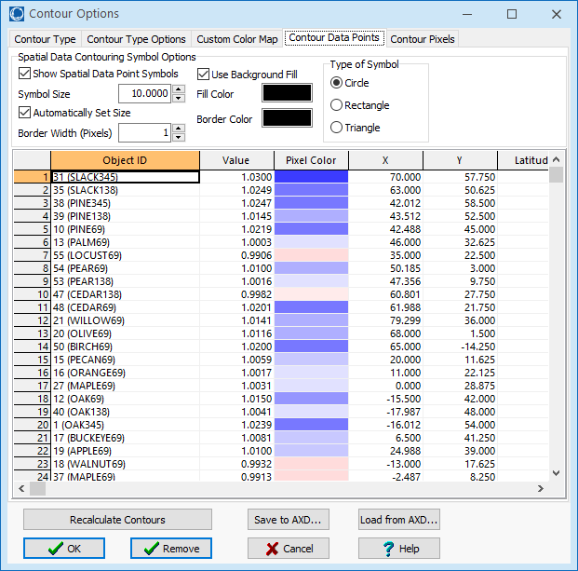
PowerWorld Contouring
Contouring can be used to better see system-wide values such as voltages
PowerWorld popularized contouring in power flow around the year 2000
To contour the data on a oneline, right-click and select Contouring

Slide 6
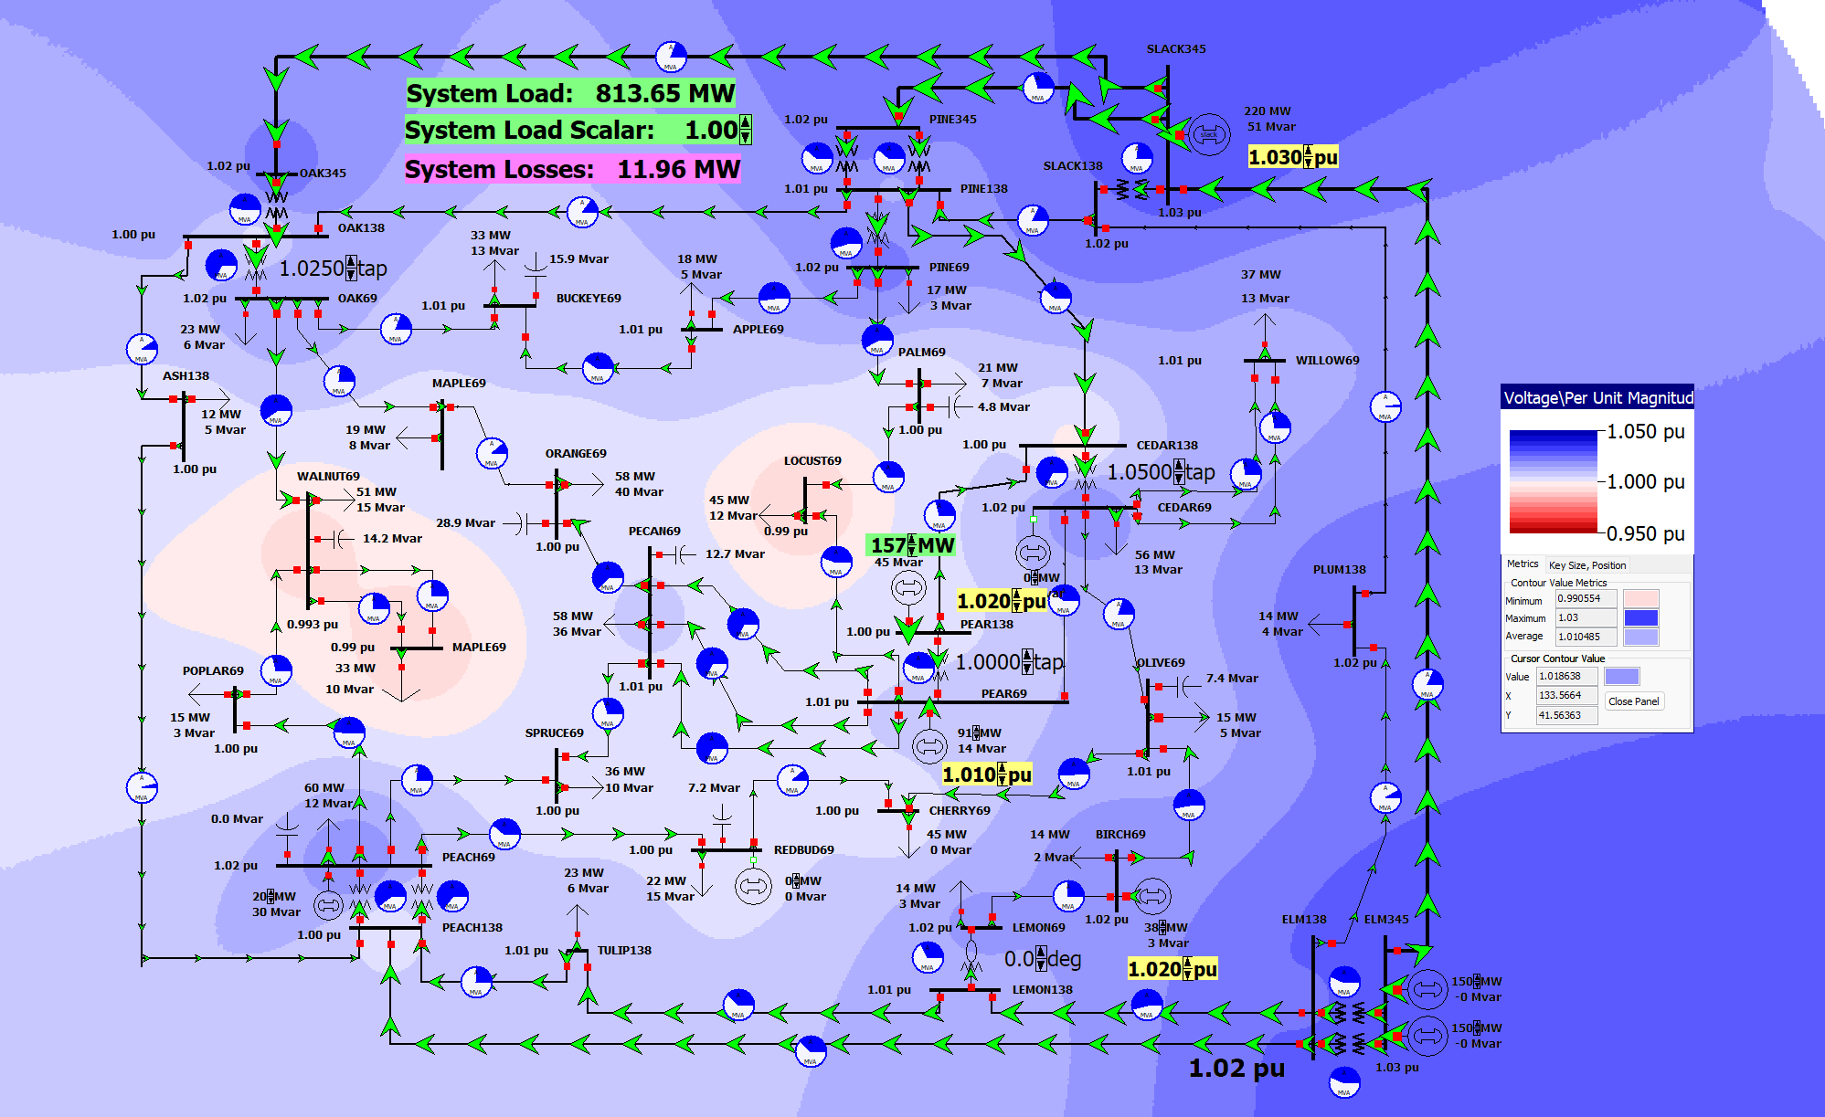
37 Bus Voltage Contour

Slide 7
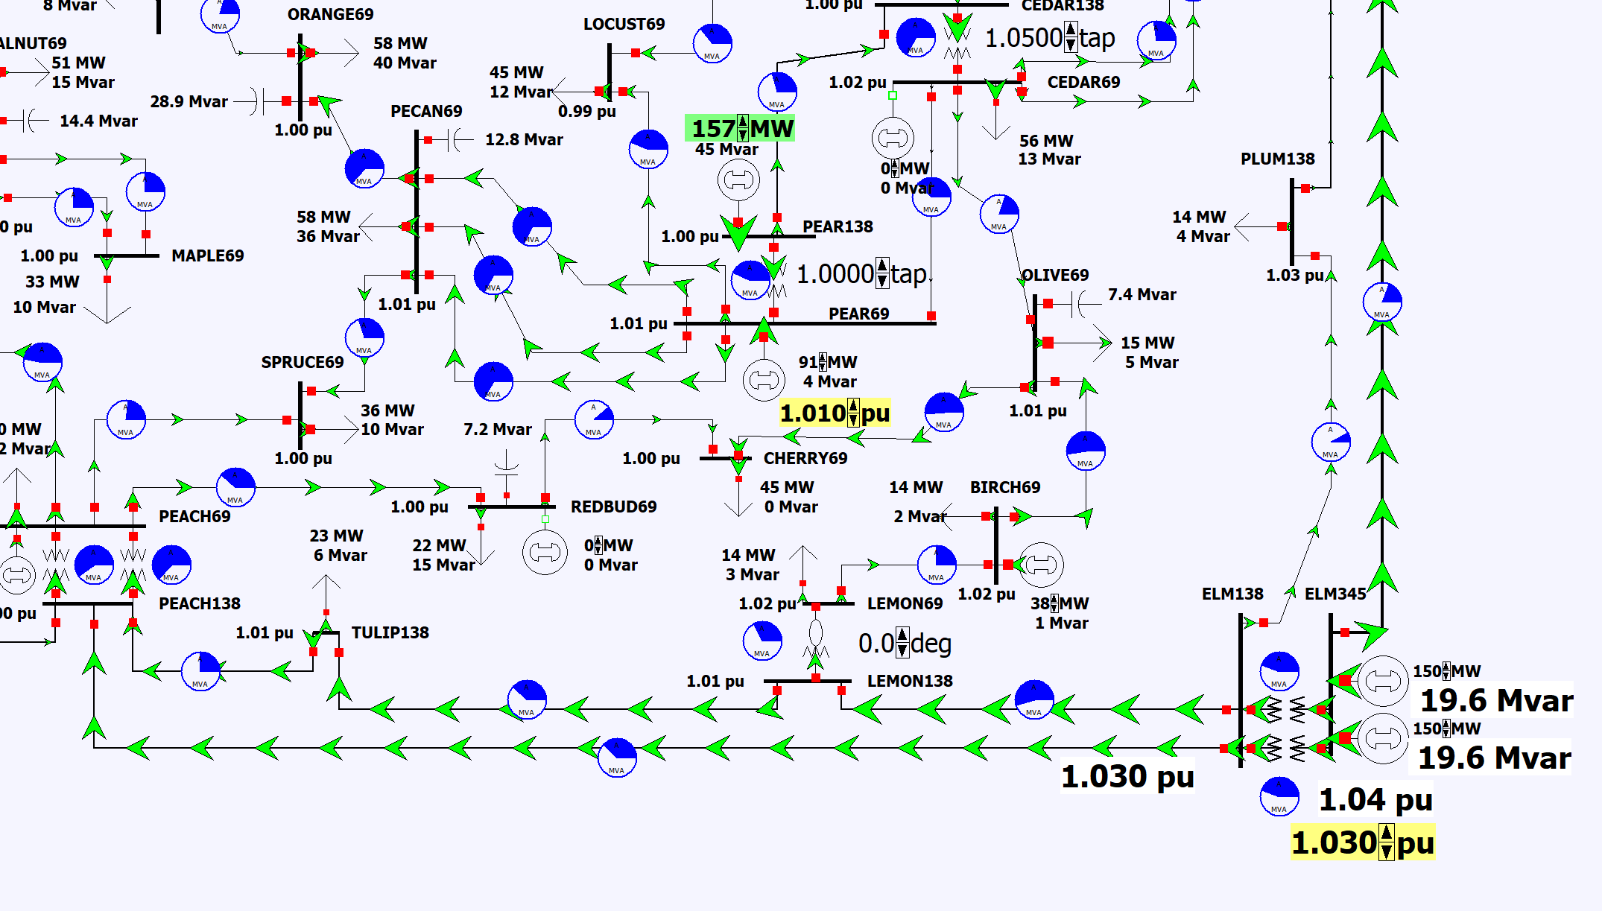
Reactive Power Sharing
Sometimes multiple generators regulate a single location, which might be there terminal bus; this involves coordination
To see an example, open the case PSC_37Bus_VarSharing
Change the voltage setpoint at Elm345; notice that the reactive power output of both generators changes

Slide 8
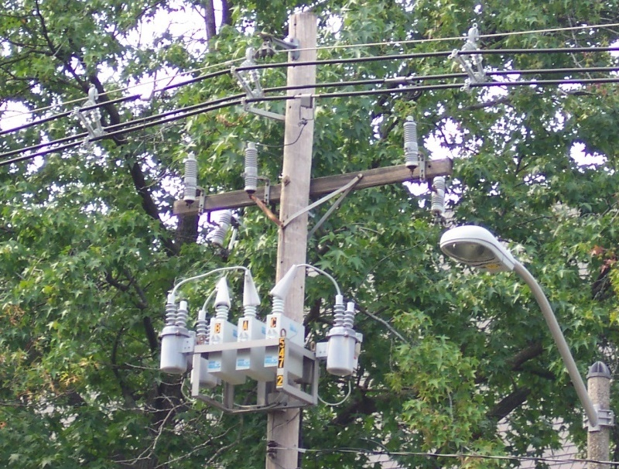
Switched Shunts and SVCs
Switched capacitors and sometimes reactors (collectively known as switched shunts) are widely used at both the transmission and distribution levels to supply or (for reactors) absorb discrete amounts of reactive power
Static var compensators (SVCs) are also used to supply continuously varying amounts of reactive power
In the power flow SVCs are sometimes represented as PV buses with zero real power
Switched shunts are passive devices so their output varies with the square of the voltage; they are usually specified at nominal (1.0 per unit) voltage

Slide 9
Switched Shunt System Design
Because switched shunts tend to have a local impact, there needs to be a coordinated design in their implementation at the transmission level
Shunt capacitors used to raise the voltage, shunt reactors used to lower the voltage; used with LTCs and gens
Often in the transmission system they are switched manually by a system operator, but in the power flow much of this needs to be automated
The size and number of banks depends
Change in the system voltages caused by bank switching
The availability of different sizes
Cost for the associated switchgear and protection system

Slide 10
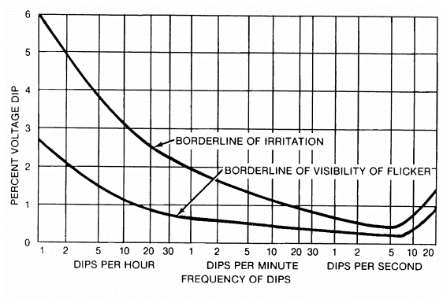
Switched Shunt Sizing
A goal with switched shunt sizing is to avoid human irritation caused by excessive changes in lighting
IEEE Std 1453-2015 gives guidance on the percentage of voltage changes as a function of time; Table 3 of the standard suggests keeping the voltage changes below about 3%
Analytic sensitivity methods (next week) can be used to calculate this percentage
Image from IEEE Std. 1453-2015, “IEEE Recommended Practice for Measurement and Limits of Voltage Fluctuations and Associated Light Flicker on AC Power Systems”
This standard has been modified for the changings in lighting technology

Slide 11
Dynamic Reactive Capability
Switched shunts are often used to maintain adequate dynamic reactive power from generators and SVCs
FERC Order 827 (from June 2016, titled “Reactive Power Requirements for Non-Synchronous Generation”) states that the power factor of generators should be between 0.95 leading to 0.95 lagging
Hence the absolute value of the Mvar output of the machines should be no more than 31% of the MW output
Often a value substantially better for reactive reserves
Recent FERC orders on generators are available at www.ferc.gov/electric-transmission/generator-interconnection/final-rules-establishing-and-revising-standard
Switched shunts are used to keep the generator power factor within this range

Slide 12
Switched Shunt Control
In a real power grid often the shunts are manually switched by the operator
In the power flow this action can be simulated by an outer loop algorithm,
Because they are discrete, they need to regulate a value to a voltage range; the range should not be too narrow
Switches shunts often have multiple levels that need to be simulated; these levels represent the switching of individual devices
Switched shunt control also interacts with the LTC and generator PV control
The power flow modeling needs to implicitly take into account the control time delays associated with the various devices

Slide 13
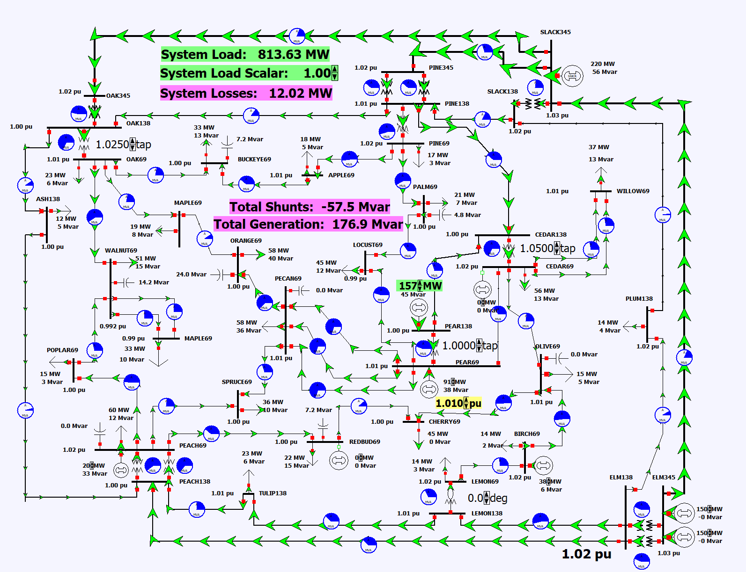
Switched Shunt Control Example: Modifying the PSC_37Bus case
Open the case PSC_37Bus_SwitchedShunts; this is setup to have the switched shunts on automatic control
Start the simulation, and manually change the shunt at Walnut69; notice the voltage change; then adjust the System Load Scalar, and notice the global change in the switched shunts
Note that in moving the Load Scalar down and back up to the same value the solution may not be the same
This is because of the discrete control ranges

Slide 14
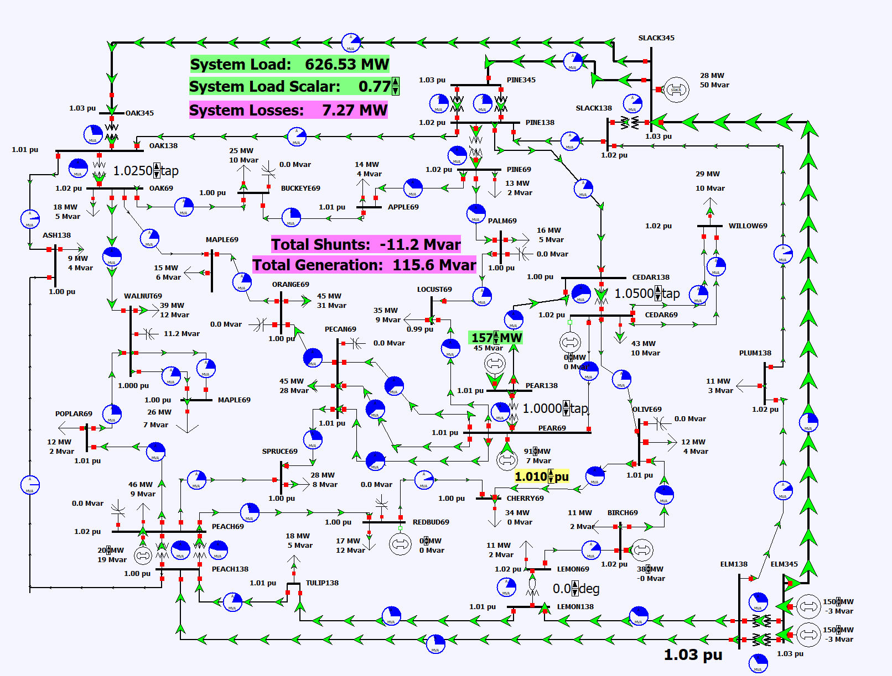
Static Var Compensators (SVCs)
If continuously varying reactive power is desired, it can be provided by static var compensators (SVCs)
SVCs combined a fixed reactive power device (e.g., a capacitor), with switched devices to provide rapid output variation, mimicking generator reactive control
A 2012 report puts SVC costs at about four times that of regular shunts ($80,000 per Mvar versus $20,000) [1]
To see an SVC example, open the case PSC_37Bus_SVC
(1) www.efis.psc.mo.gov/Document/Display/280923

Slide 15
Modeling Transformers with Off-Nominal Taps and Phase Shifts
If transformers have a turns ratio that matches the ratio of the per unit voltages than transformers are modeled in a manner similar to transmission lines.
However, it is common for transformers to have a variable tap ratio; this is known as an “off-nominal” tap ratio
The off-nominal tap can be a real number or complex number (i.e., with a phase shift)
When the magnitude of the turns ratio can be changed while the transformer is energized it is called a Load Tap Changer (LTC) transformer or sometimes On Load Tap Changer (OLTC)
When the phase angle can be changed a transformer is call a phase shifter or a phase angle regulator (PAR)

Slide 16
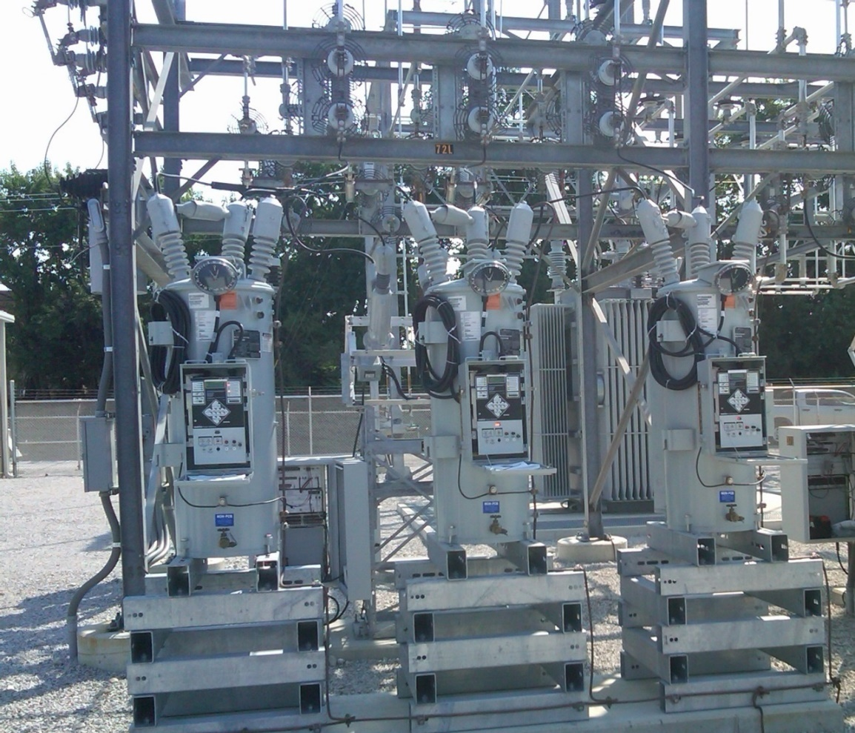
Variable Tap Voltage Control
An LTC is a discrete control, often with 32 incremental steps of 0.625% each, giving an automatic range of ± 10%
However, the tap changes in discrete steps; there is also a built-in time delay in how fast they respond
Voltage regulators are devices with a unity nominal ratio, and then a similar tap range
Ameren 69/12.4 kV transformer; with voltage regulation; each phase can be regulated separately

Slide 17
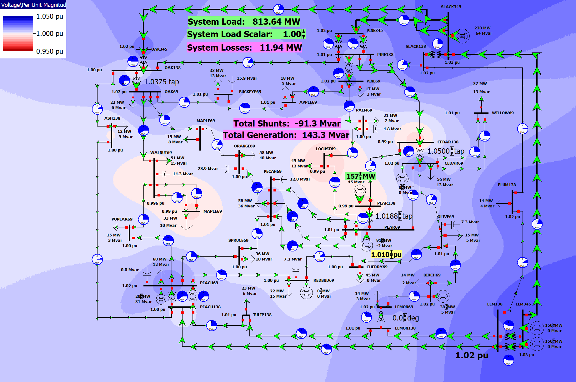
LTC Control and the Power Flow
LTCs can either be on automatic control or manual control; both can be implemented in the power flow
Open the case PSC_37Bus; taps for three LTCs are shown; contour the voltage, start the simulation, and modify the taps
Notice that changing the taps increases the voltage on one side and decreases it on the other
Right-click on the transformer and use its dialog to place it on automatic control

Slide 18
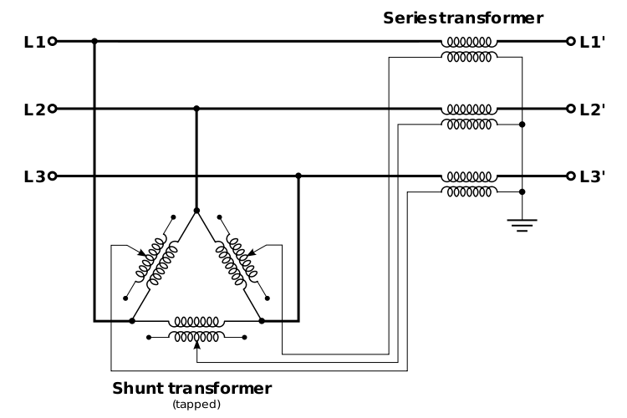
Phase-Shifting Transformers
Phase shifters are transformers in which the phase angle across the transformer can be varied in order to control real power flow
Sometimes they are called phase angle regulators (PARs)
Quadrature booster (evidently British though I’ve never heard this term)
They are constructed by include a delta- connected winding that introduces a 90º phase shift that is added to the output voltage
Image: http://en.wikipedia.org/wiki/Quadrature_booster

Slide 19
Integrated Phase-Shifter Control
Phase shifters are usually used to control the real power flow on a device
Similar to LTCs, phase-shifter control can either be directly integrated into the power flow equations (adding an equation for the real power flow equality constraint, and a variable for the phase shifter value), or they can be handled in with an outer loop approach
As was the case with LTCs, limit enforcement often makes the outer loop approach preferred
Coordinated control is needed when there are multiple, close by phase shifters
Commonly used to control interface flow, such as between the US and Canada

Slide 20
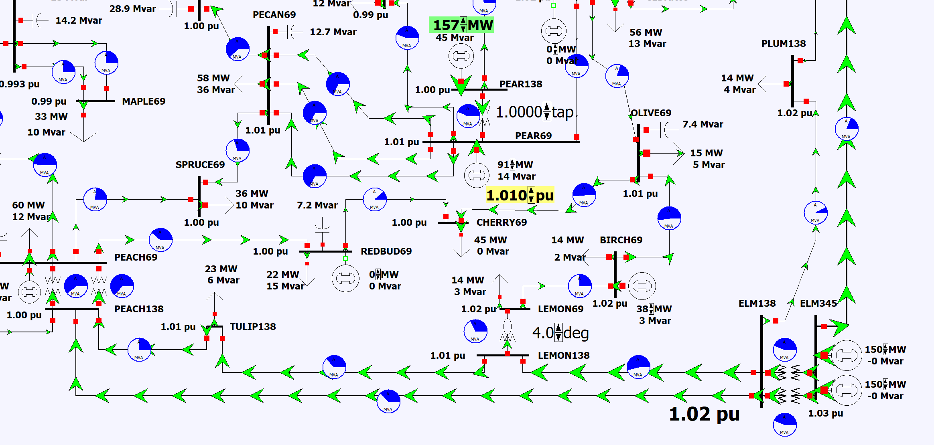
Phase Shifter Example
Again open the PSC_37Bus case, start the simulation, and adjust the phase angle on the transformer at the LEMON substation

Slide 21
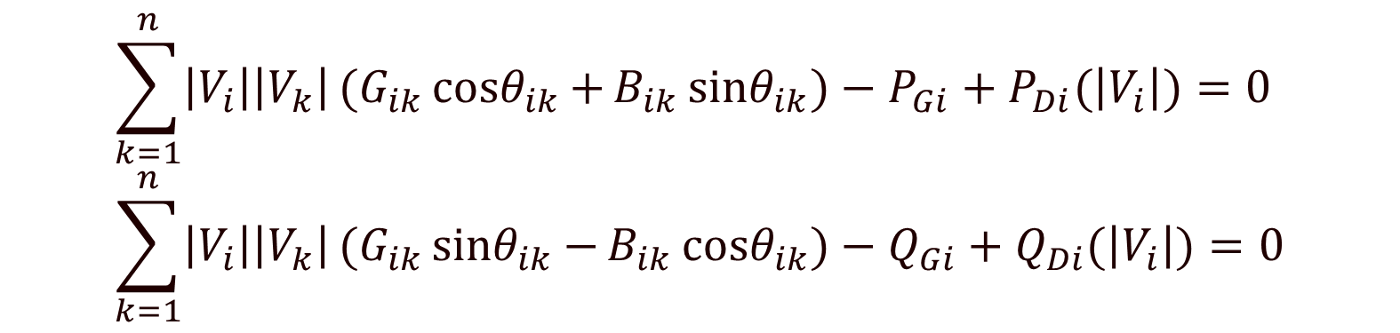
Modeling Voltage Dependent Load
So far we′ve assumed that the load is independent of the bus voltage ("i.e., constant power). However, the power flow can be easily extended to include voltage dependence with both the real and reactive load.
$$\sum_{k=1}^{n}{\left|V_{i}\right|\left|V_{k}\right|}(G_{ik}{cosθ}_{ik}{+}B_{ik}{sinθ}_{ik}{)}−P_{Gi}+P_{Di}(\left|V_{i}\right|)=0 \\ \sum_{k=1}^{n}{\left|V_{i}\right|\left|V_{k}\right|}(G_{ik}{sinθ}_{ik}{−}B_{ik}{cosθ}_{ik}{)}−Q_{Gi}+Q_{Di}(\left|V_{i}\right|)=0$$

Slide 22
ZIP Load Model
A common load model is the ZIP, in which the load is represented as
The Z is for the constant impedance part, the I for the constant current, and the P for constant power

Slide 23
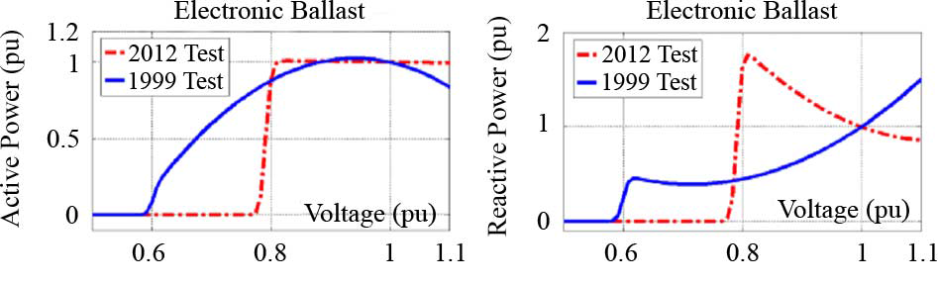
ZIP Model Coefficients
An interesting paper on the experimental determination of the ZIP parameters is A. Bokhari, et. al., "Experimental Determination of the ZIP Coefficients for Modern Residential and Commercial Loads, and Industrial Loads," IEEE Trans. Power Delivery, 2014
Presents test results for loads as voltage is varied; also highlights that load behavior changes with newer technologies
Below figure (part of fig 4 of paper), compares real and reactive behavior of light ballast

Slide 24
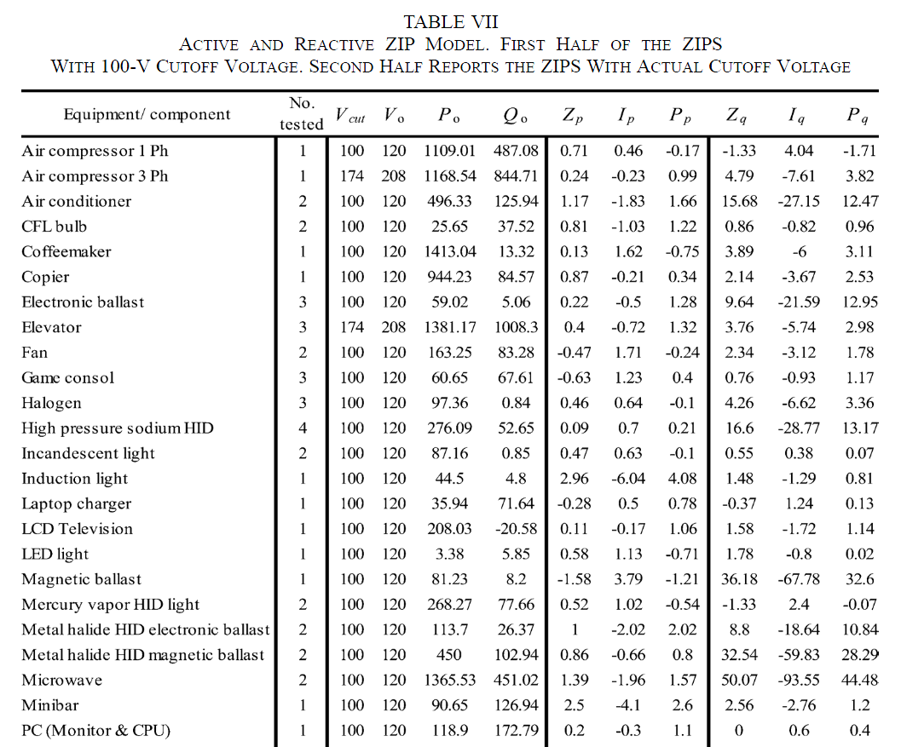
ZIP Model Coefficients
The Z,I,P coefficients sum to zero; note that for some models the absolute values of the parameters are quite large, indicating a difficult fit
A portion of Table VII from Bokhari 2014 paper

Slide 25
Justification for the Common Power Flow Constant Power Model
While many loads do exhibit voltage dependence, there is good justification for using a constant power model in the power flow
A major justification is since the power flow is a steady-state analysis tool and is usually focused on representing load at the transmission system level, the assumption is the distribution tap-changing transformers have had enough time to respond so that in steady-state the voltage magnitude seen by the load is mostly independent of the transmission level voltage
Another justification is that in the longer term power flow time frame since many loads have external controllers (i.e., thermostats for heating) when their behavior is aggregated over time they tend to look like constant power

Slide 26
Larger Systems
In North America the standard planning models range in size from about 7000 buses to 80,000 buses
Smaller, equivalent models can be created (we’ll cover equivalencing later in this talk)
Here we’ll be using a 2000-bus, geographically-based synthetic model covering the Texas footprint and a 24,000-bus, geographically-based synthetic model covering (roughly) the US portion of the SPP and MISO
Realistic synthetic grids are fictional (avoiding CEII issues) but match the complexity of the actual grid
The size is a tradeoff between more realistic (larger) and computational constraints (smaller is quicker)
A key challenge with studying larger grids is understanding what is actually occurring during the power flow solutions

Slide 27
Quick Aside: Synthetic Electric Grids
In many places worldwide access to data about the actual power grid is restricted because of needs for confidentiality (e.g., CEII in USA)
Data and models are sometimes available through NDAs, but ability to publish limited
To do effective research and teaching, and to drive innovation, researchers need access to common, realistic grid models and data sets
Scientific principle of reproducibility of results
Ten years back most existing public test cases did not match the complexity of actual grids; over the last eight years tremendous progress has been made through the U.S. ARPA-E Grid Data Program in creating large-scale, high quality, realistic synthetic grids
These cases are useful for classes, such as this one

Slide 28
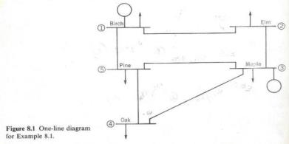
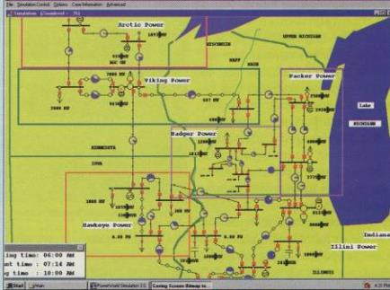
Quick Aside: Synthetic Electric Grids
Our approach has been to make grids that look real and familiar by siting them geographically (e.g., North America) and serving a population density the mimics actual
Electric grids are designed to operate over time
Building synthetic electric grids is a great grid planning exercise
One encounters many of the challenges with designing the actual grid
A non-geographic grid
A pseudo-geographic grid
Top Image Source: W.D. Stevenson, Elements of Power Systems, Fourth Edition, McGraw-Hill Book Company New York, 1982 (the first edition was in 1955)

Slide 29
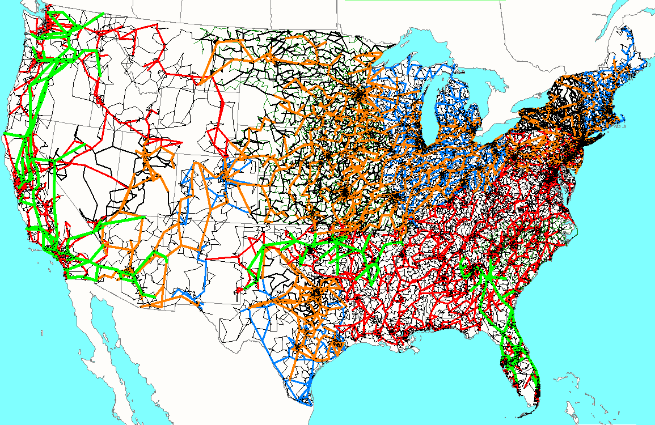
82,000 Bus Synthetic Grid
The different colors indicate different nominal kV voltages, with green 765, orange 500, red 345, blue 230, black lower.
This is the synthetic grid we used for the synthetic grid portion of the SPP looking at joining the East and West grids. We hope to develop models for other countries and are in the process of adding additional detail; creating realistic synthetic grids is challenging since real grids involve lots of engineering

Slide 30
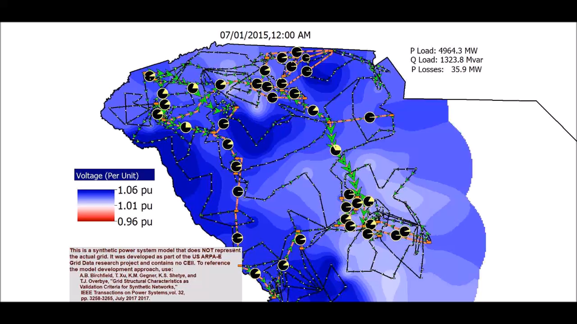
500-Bus Hourly Voltage Variation Over a Week

Slide 31
Large System Power Flow Challenges
Power flow solutions with systems of up to 80,000 buses are now common and they can be solved quickly using sparse matrix techniques
Using sparse matrix techniques the computation scales on the order of n^{1.4} (ten times larger takes 25 times more computation)
There can be computational bottlenecks associated with outer loop controls, like LTCs and switched shunts, and generator PV/PQ switching
Larger systems usually have at least some unusual modeling situations, and often they contain at least some bad data
Understanding what took place during solution can be an issue, though visualization helps
Different power flow applications require different levels of insight into the final solution

Slide 32
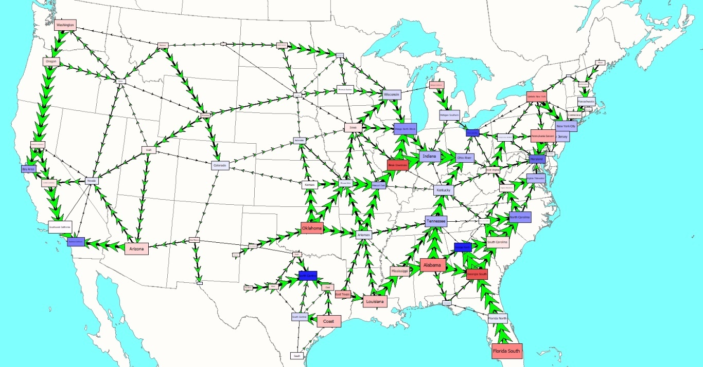
Areas, Zones, Ownership and Superareas
Larger systems are almost always divided into a number of different subdivisions, with the most common being areas and zones; PowerWorld also can group areas into superareas and can group items by ownership
Areas (sometimes known as balancing authority areas) are used for coordinated dispatch of generation, with each area keeping track of its net interchange by summing the flow of power on its tie-lines
Zones are usually just used for grouping items
Not all the devices at a bus need to be within the same area or zone
A superarea is a group of areas
82K bus grid area visualization

Slide 33
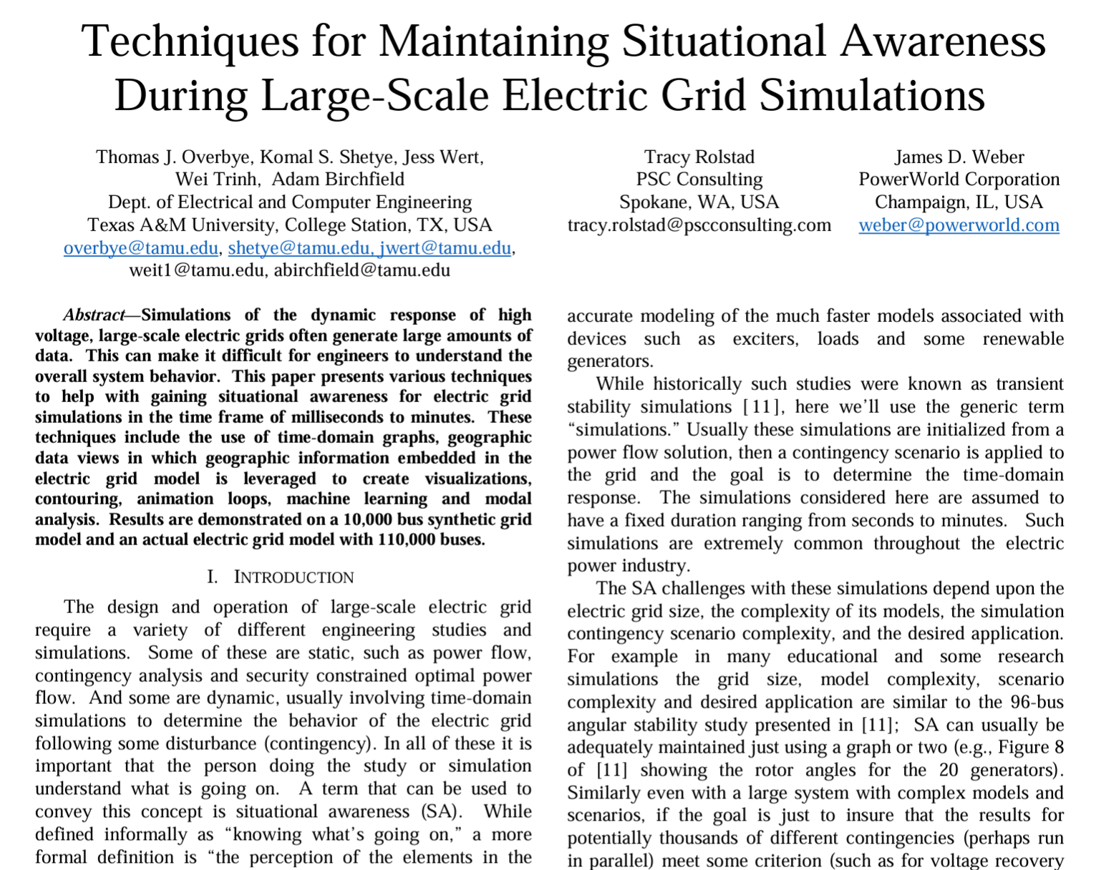
Engineering Study Situational Awareness
The term “Situational Awareness” (SA) came into power grid usage after the 8/14/03 blackout
While SA is mostly associated with operations, the same term (informally defined as “knowing what’s going on”) it certainly applies to engineering studies as well, such as with large grids
T.J. Overbye, K.S. Shetye, J.L. Wert, W. Trinh, and A. Birchfield, “Techniques for Maintaining Situational Awareness During Large-Scale Electric Grid Simulations,” IEEE Power and Energy Conference at Illinois (PECI), Champaign, IL, April 2021. Available at overbye.engr.tamu.edu/publications/

Slide 34
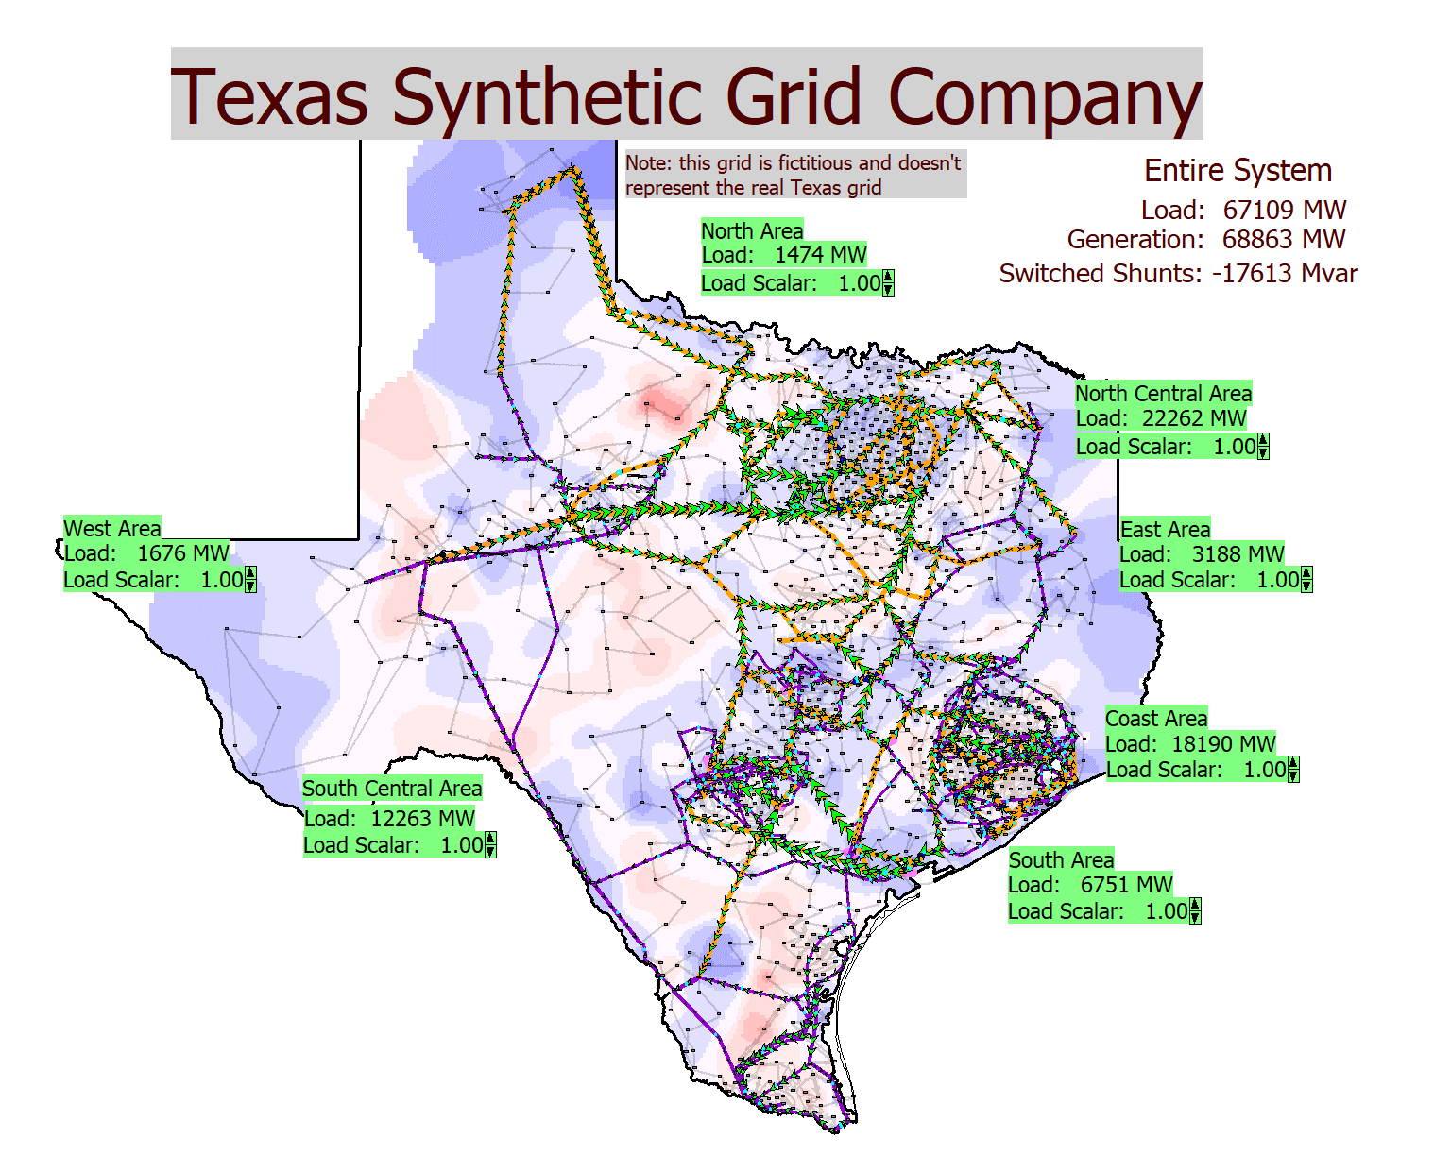
Texas 2000-Bus Synthetic Grid
Open the case PSC_2000_PowerFlow
While it is relatively easy to solve a power flow, the challenge is to understand what is going on
With this display the load can be easily changed, but this results in a potentially large number of other changes

Slide 35
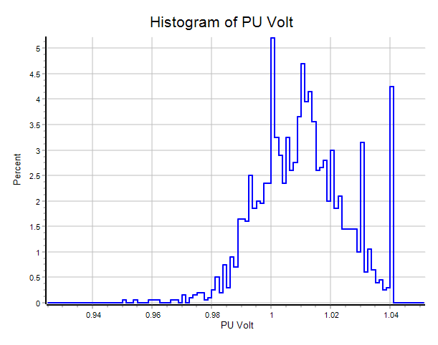
Exploring a Case Using Model Explorer
As an aside, File, General File Browser can be used to find cases and actually many other files as well (I use it all the time to find many types of files, including ppts!)
The Case Information menu contains lots of ways to view a case; difference flows can be helpful in looking at differences between solutions
On a case info display, right-click and select Display/Column options to customize the fields that are shown; Get Column Metrics provides lots of information, including now histograms of any field

Slide 36
PSC_2000_PowerFlow Line Contingency
If not already open, open the PSC_2000_PowerFlow case then
Solve it (it is essentially already solved),
Open the log (tools, log or the button), clear the log (right-click on the log and select Clear Window),
Open the line between buses 5236 and 5394 (which has about 780 MW of flow), Solve the power flow
Examine the log; notice that a fair amount of automatic control actions took place
Repeat the previous process, except use the PowerWorld Difference Case functionality to compare the two solutions
after the case has been opened and solved, select Tools, Difference Case, Set Present as Base, do the above procedure to solve the contingency, then select Tools, Difference Case, Difference Mode to view the differences
Afterward select Tools, Difference Case, Present Mode to restore the contingency solution

Slide 37
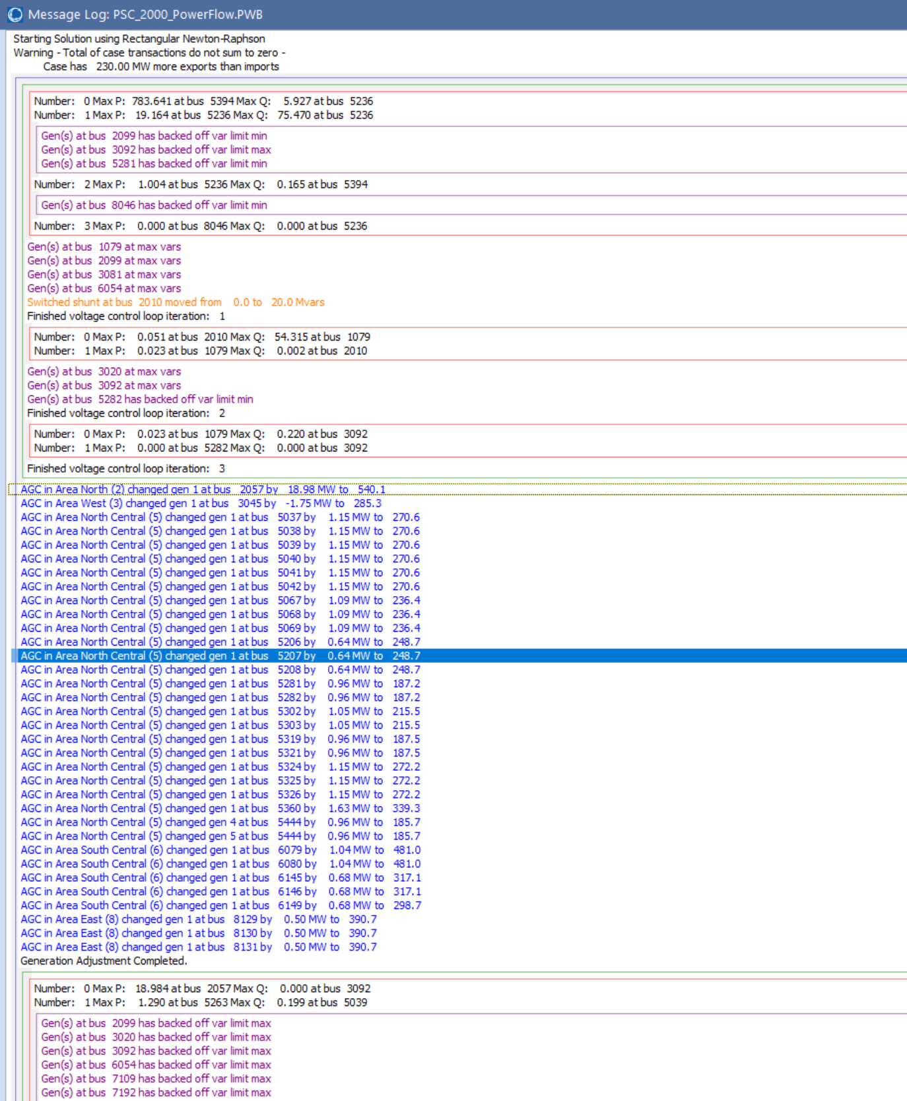
PSC_2000_PowerFlow Line Contingency Log
Selecting Tools, Log can show more information about the solution

Slide 38
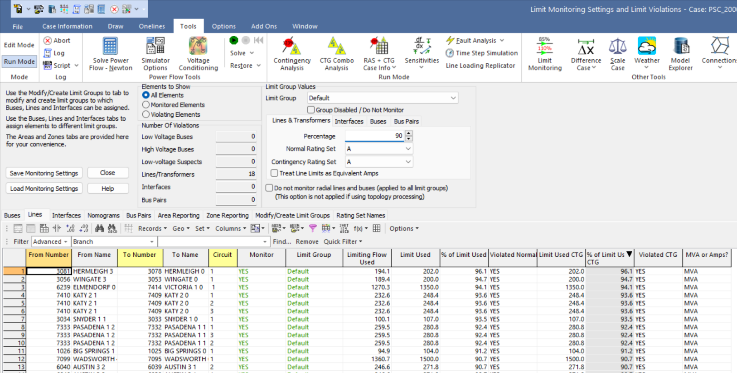
Viewing Limit Violations
Often the goal of the power flow is to determine if there are any limit violations in the solution. There are many ways to find limit violations, including onelines, and regular, sorted case information displays
The Limit Monitoring Form can also be used
Select Tools, Limit Monitoring to view this form
On Elements to Show select Violating Elements; to see some violations, narrow the limits until some violations occur

Slide 39
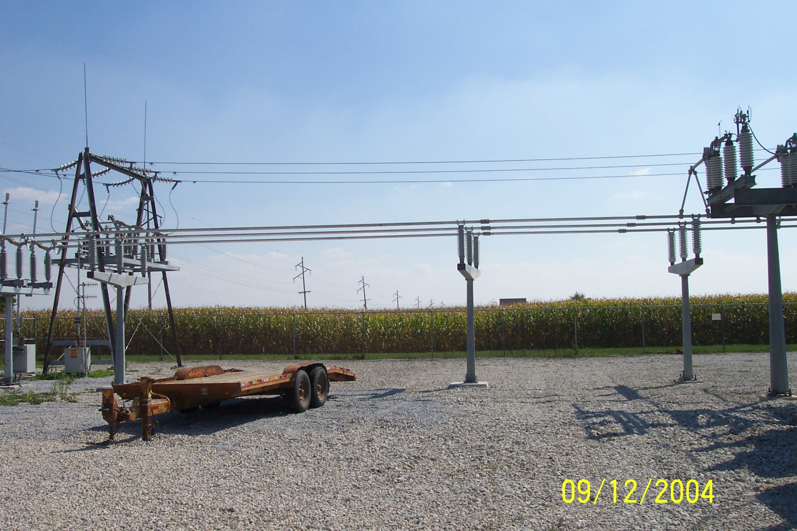
Power Flow Topology

Slide 40
Circuit Breakers and Disconnects
Circuit breakers are devices that are designed to clear fault current, which can be many times normal operating current
AC circuit breakers take advantage of the current going through zero twice per cycle
Transmission faults can usually be cleared in less than three cycles
Disconnects cannot clear fault current, and usually not normal current. They provide a visual indication the line is open. Can be manual or motorized.
In the power flow they have essentially no impedance; concept of a zero branch reactance (ZBR)

Slide 41
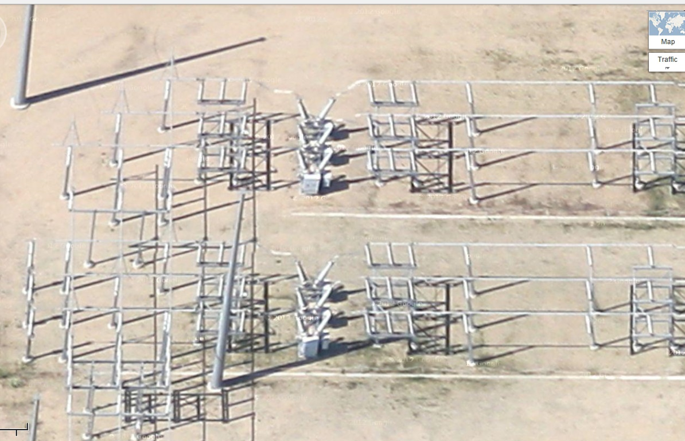
Google View of a 345 kV Substation

Slide 42
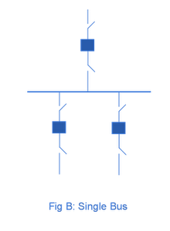
Substation Configurations
Several different substation breaker/disconnect configurations are common:
Single bus: simple but a fault any where requires taking out the entire substation; also doing breaker or disconnect maintenance requires taking out the associated line
Source: http://www.skm-eleksys.com/2011/09/substation-bus-schemes.html

Slide 43
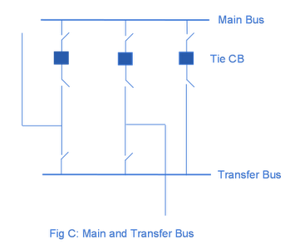
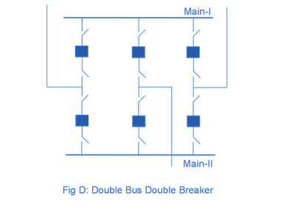
Substation Configurations, cont.
Main and Transfer Bus: Now the breakers can be taken out for maintenance without taking out a line, but protection is more difficult, and a fault on one line will take out at least two
Double Bus Breaker: Now each line is fully protected when a breaker is out, so high reliability, but more costly
Source: http://www.skm-eleksys.com/2011/09/substation-bus-schemes.html

Slide 44
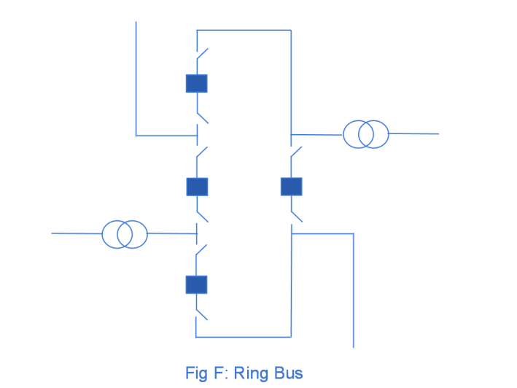
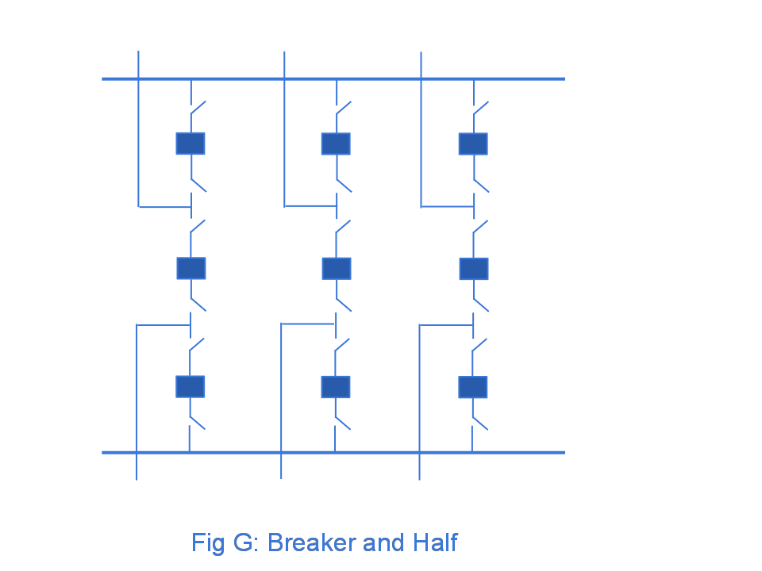
Ring Bus, Breaker and Half
As the name implies with a ring bus the breakers form a ring; number of breakers is same as number of devices; any breaker can be removed for maintenance
The breaker and half has two buses and uses three breakers for two devices; both breakers and buses can be removed for maintenance
Source: http://www.skm-eleksys.com/2011/09/substation-bus-schemes.html

Slide 45
EMS and Planning Models
EMS Model
Used for real-time operations
Called full topology model
Has node-breaker detail
Planning Model
Used for off-line analysis
Called consolidated model by PowerWorld
Has bus/branch detail
-30 MW
-18 Mvar
-30 MW
-18 Mvar
50 MW
20 Mvar
10 MW
3 Mvar
10 MW
3 Mvar
-40 MW
-10 Mvar
10 MW
5 Mvar
-40 MW
-10 Mvar
10 MW
5 Mvar

Slide 46
Node-Breaker Consolidation
One approach to modeling systems with large numbers of ZBRs (zero branch reactances, such as from circuit breakers) is to just assume a small reactance and solve
This results in lots of buses and branches, resulting in a much larger problem
This can cause numerical problems in the solution
The alterative is to consolidate the nodes that are connected by ZBRs into a smaller number of buses
After solution all nodes have the same voltage; use logic to determine the device flows

Slide 47
Bus Branch versus Node Breaker
Due to a variety of issues during the 1970’s and 1980’s the real-time operations and planning stages of power systems adopted different modeling approaches
Real-Time Operations
Use detailed node/breaker model
EMS system as a set of integrated applications and processes
Real-time operating system
Real-time databases
Planning
Use simplified bus/branch model
PC approach
Use of files
Stand-alone applications
Entire data sets and software tools developed around these two distinct power system models, though they are now starting to merge

Slide 48
Power Flow Topology Processing
Commercial power flow software must have algorithms to determine the number of asynchronous, interconnected systems in the model
These separate systems are known as Islands
In large system models such as the Eastern Interconnect it is common to have multiple islands in the base case (one recent EI model had nine islands)
Islands can also form unexpectedly as a result of contingencies
Power can be transferred between islands using dc lines
Each island must have a slack bus

Slide 49
Power Flow Topology Processing
Anytime a status change occurs the power flow must perform topology processing to determine whether there are either 1) new islands or 2) islands have merged
Determination is needed to determine whether the island is “viable.” That is, could it truly function as an independent system, or should the buses just be marked as dead
A quite common occurrence is when a single load or generator is isolated; in the case of a load it can be immediately killed; generators are more tricky

Slide 50
Quasi-Newton Power Flow Methods
Over the years there have been many methods presented to speed-up the Newton power flow (NPF)
Since most of the computation in the NPF is associated with building and factoring the Jacobian matrix, J, the focus is on trying to reduce this computation
In a pure NPF J is build and factored each iteration, so most methods focus on a simplification with the Jacobian
Whether a method is effective can be application dependent
For example, in contingency analysis we are usually just resolving a solved case with an often small perturbation
The most severe, but sometimes useful approximation is the DC power flow

Slide 51
DC Power Flow
The “DC” power flow makes the most severe approximations:
completely ignore reactive power, assume all the voltages are always 1.0 per unit, ignore line conductance
This makes the power flow a linear set of equations, which can be solved directly
The term dc power flow actually dates from the time of the old network analyzers (going back into the 1930’s)
Not to be confused with the inclusion of HVDC lines in the standard NPF
P sign convention is generation is positive

Slide 52
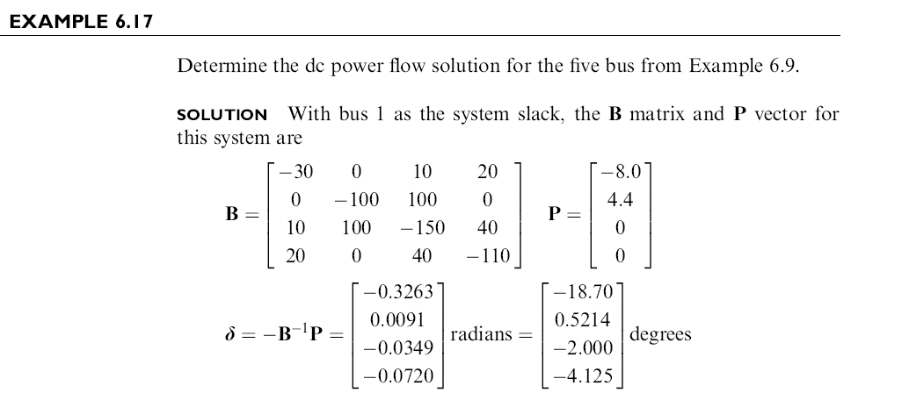
DC Power Flow Example
Example from Power System Analysis and Design, by Glover, Overbye, Sarma, 6th Edition

Slide 53
DC Power Flow in PowerWorld
PowerWorld allows for easy switching between the dc and ac power flows (case is PSC_37Bus)
To use the dc approach in PowerWorld select Tools, Solve, DC Power Flow
Notice there are no losses

